Slide 1
Secure data hiding in image using steganography
CAPSTONE PROJECT
Presented By:
Student Name : Kanekal Toufiq
College Name & Department : Srinivasa Ramanujan institute of technology , Department of Electronics and Communication

Slide 2
OUTLINE
Problem Statement
Technology used
Wow factor
End users
Result
Conclusion
Git-hub Link
Future scope

Slide 3
Problem Statement
This project deals with the safeguarding of classified information by concealing it within a digital image using steganography techniques. It meets the requirement of the privacy and confidentiality of the user during communication since users can now send concealed messages embedded in normal appearing images. The problem is that the process of extraction must be done securely so that the concealed message is imperceptible to unauthorized users but still retrievable by the intended recipient.

Slide 4
Technology used
Python:
The project is implemented in Python, known for its simplicity and versatility in handling tasks like image manipulation and cryptography. Python's cv2 (OpenCV) library is used to load, modify, and save images, allowing easy access to pixel-level data for embedding the secret message.
Steganography:
Steganography is used to hide messages within images by manipulating the pixel values, specifically targeting the least significant bits (LSBs). The message is embedded in a way that causes minimal visual distortion, ensuring the image looks normal but contains hidden data.
Password Protection:
A passcode system ensures that only authorized users can decrypt the hidden message. Users must input the correct passcode to retrieve and view the secret message embedded in the image.

Slide 5
Wow factors
The wow factor of this project lies in its combination of simplicity and effectiveness in securing sensitive data. By embedding a secret message within an image, the project showcases how steganography can be used to hide information in plain sight, making it undetectable to anyone unaware of the technique.
The added passcode protection ensures that only authorized individuals can access the hidden message, adding an extra layer of security. This combination of data concealment and access control makes the system both intriguing and practical for real-world applications.
Steganography in this project has vast potential for secure communication, allowing individuals or organizations to exchange confidential information without raising suspicion. It can also be used for covert data transfer, where messages are hidden within media files to avoid detection by unauthorized parties. Additionally, the concept could be adapted for digital watermarking, helping protect intellectual property and track media usage.

Slide 6
End users
Private Individuals: This system is ideal for individuals who want to send confidential messages or personal data securely without the risk of interception. It provides a discreet way to communicate without exposing sensitive information to potential hackers or third parties.
Organizations: For businesses, the system can be used to protect internal communications and ensure confidentiality when sharing sensitive data. It’s particularly useful for ensuring that trade secrets, financial records, and employee information remain private within corporate networks.
Cybersecurity Experts: The project serves as a tool for cybersecurity professionals who study and develop methods for secure communications. It can also be used in research related to data protection and cryptographic techniques, contributing to the development of more advanced security measures.

Slide 7
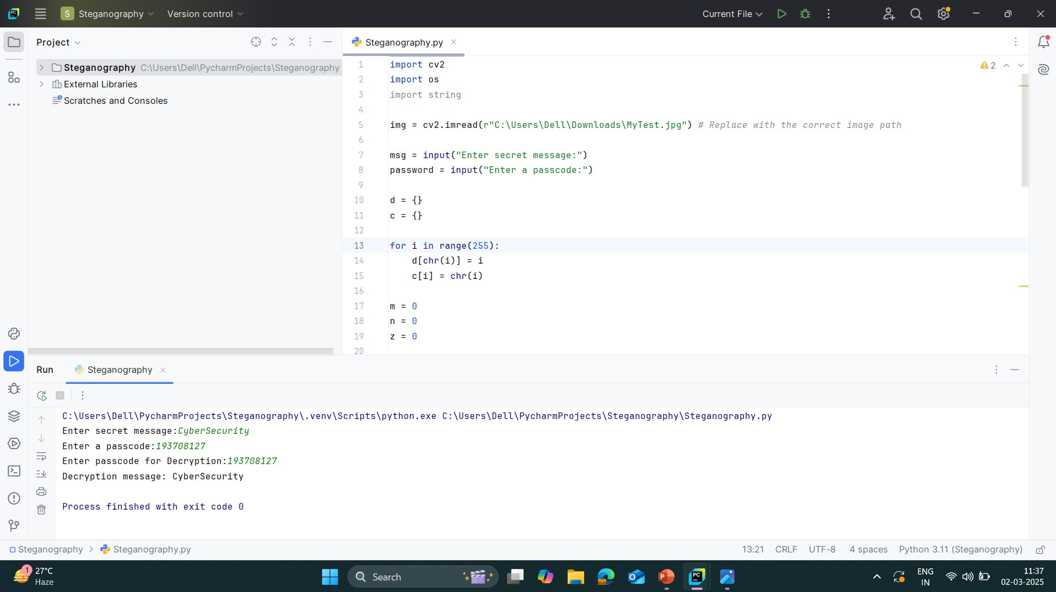

Results

Slide 8
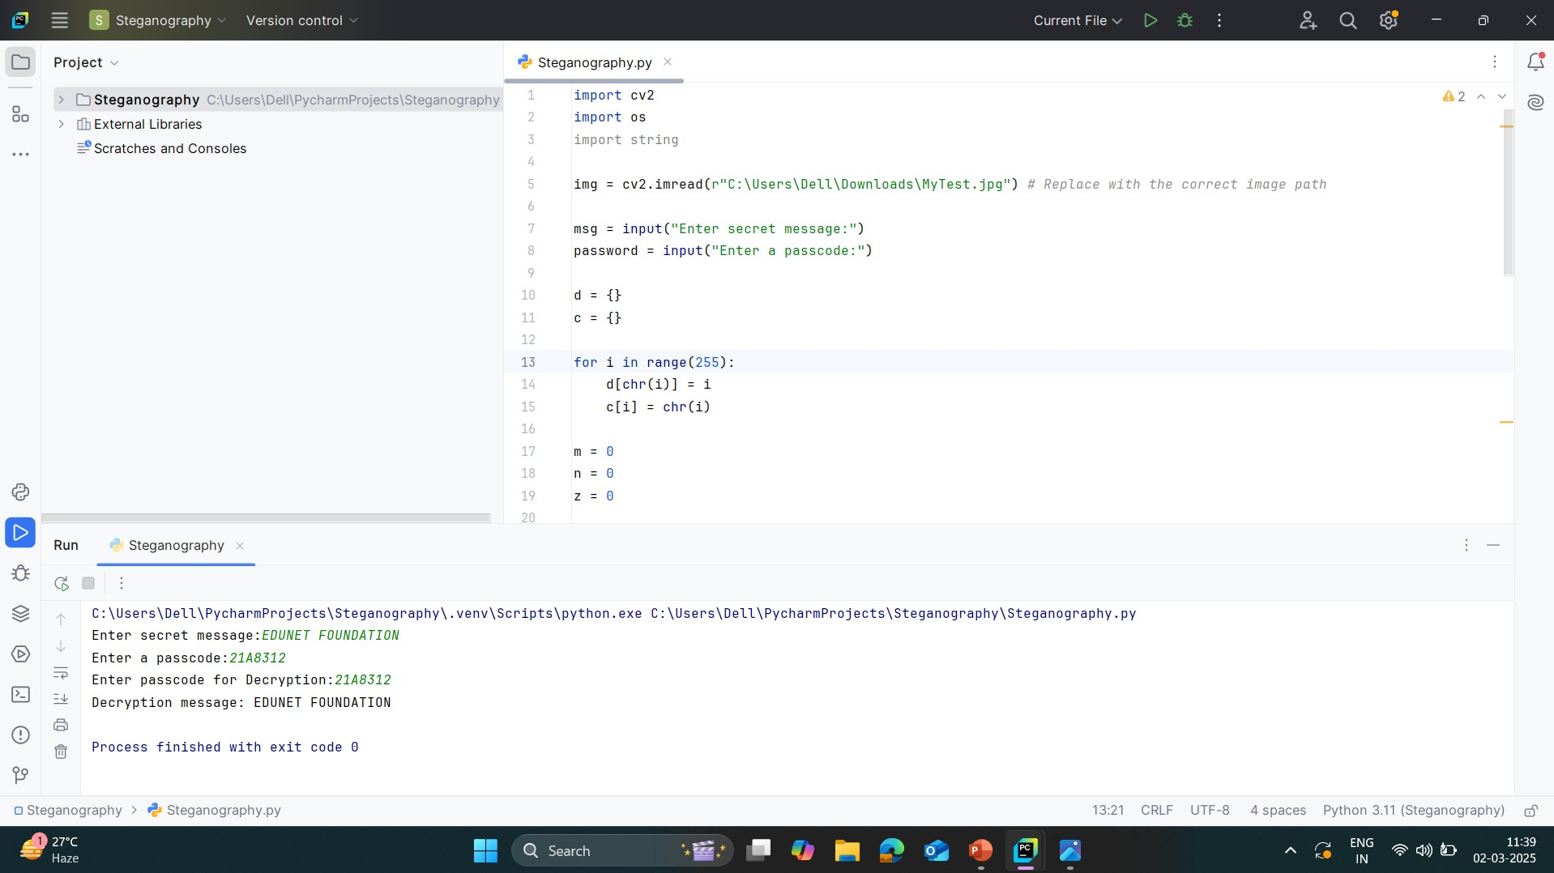
Results

Slide 9

Results

Slide 10
Conclusion
This project successfully ensures the safeguarding of classified information by embedding messages within digital images using steganography. By maintaining the privacy and confidentiality of users during communication, it allows secure message transmission without raising suspicion. The effectiveness of this approach lies in its ability to make the concealed message imperceptible to unauthorized users while ensuring reliable extraction for the intended recipient. Future enhancements could focus on strengthening encryption techniques and improving robustness against attacks to further enhance security.

Slide 11
GitHub Link
https://github.com/TOUFIQKANEKAL/steganography

Slide 12
Future scope
Enhanced Security Measures: Implementing stronger encryption techniques alongside steganography to increase protection against attacks.
Adaptive Algorithms: Developing adaptive steganographic techniques that adjust to different image formats and resolutions for better concealment.
Robust Extraction Mechanisms: Improving retrieval methods to ensure message extraction remains secure even in cases of image compression or format changes.
AI-Powered Detection Prevention: Using AI and machine learning to analyze and counteract steganalysis techniques that attempt to detect hidden messages.
Real-Time Communication Integration: Extending the project to support real-time secure messaging through encrypted image sharing over communication platforms.

Slide 13
THANK YOU

